Slide 1
Week 10
COMP10001

Slide 2
Let’s chat: how can you improve your coding skills between project 1 and project 2?

Slide 3
Let’s chat: how can you improve your coding skills between project 1 and project 2?
Commenting
Do your comments make your code more human-readable?
Style
Approach
Debugging

Slide 4
Let’s chat: how can you improve your coding skills between project 1 and project 2?
Commenting
Do your comments make your code more human-readable?
Do your docstrings describe function inputs, outputs and purpose?
Style
Approach
Debugging

Slide 5
Let’s chat: how can you improve your coding skills between project 1 and project 2?
Commenting
Do your comments make your code more human-readable?
Do your docstrings describe function inputs, outputs and purpose?
Style
Are your variable names descriptive?
Do you use global constants to avoid magic numbers?
Does your code comply with PEP8? Use the filter!
Approach
Debugging

Slide 6
Let’s chat: how can you improve your coding skills between project 1 and project 2?
Commenting
Do your comments make your code more human-readable?
Do your docstrings describe function inputs, outputs and purpose?
Style
Are your variable names descriptive?
Do you use global constants to avoid magic numbers?
Does your code comply with PEP8? Use the filter!
Approach
Have you use helper functions? (Not nested) Good helper functions improve readability, help with debugging and make your code more reusable!
Debugging

Slide 7
Let’s chat: how can you improve your coding skills between project 1 and project 2?
Commenting
Do your comments make your code more human-readable?
Do your docstrings describe function inputs, outputs and purpose?
Style
Are your variable names descriptive?
Do you use global constants to avoid magic numbers?
Does your code comply with PEP8? Use the filter!
Approach
Have you used helper functions? (Not nested) Good helper functions improve readability, help with debugging and make your code more reusable!
Debugging
Do you use debugging strategies or do you find yourself getting stressed?

Slide 8
What is an “exception”?

Slide 9
What is an “exception”?
Exception ~ run-time error
An event that disrupts the normal flow of the program’s instructions

Slide 10
What is an “exception”?
Exception ~ run-time error
An event that disrupts the normal flow of the program’s instructions
The program stops running

Slide 11
What is an “exception”?
Exception ~ run-time error
An event that disrupts the normal flow of the program’s instructions
The program stops running
AttributeError, IndexError, KeyError, NameError, TypeError, ValueError, FileNotFoundError, ZeroDivisionError

Slide 12
How can we use try, except and final to handle exceptions?

Slide 13
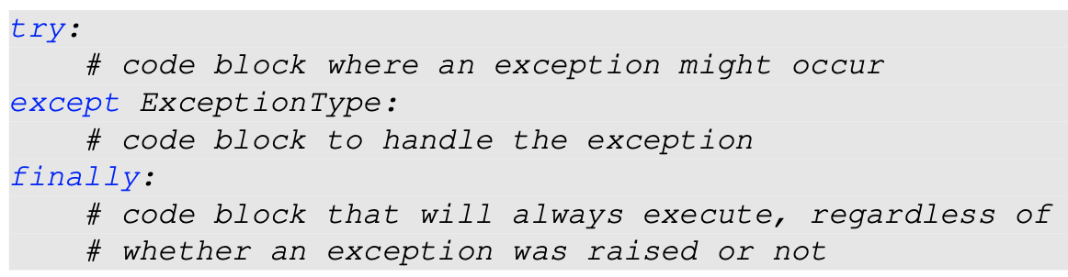
How can we use try, except and final to handle exceptions?

Slide 14
How can we use try, except and final to handle exceptions?
If an exception occurs in the “try” block, the “except” block is run to handle the exception
There can be multiple except statements after a single try

Slide 15
Write a function second_line(filename) that asks the user for the name of a file and then return the second line of the file. Use a try-except block to catch the file not found error and print the error message "Oh no, file not found". If exception is raised, return "ERROR" after printing the error message.

Slide 16
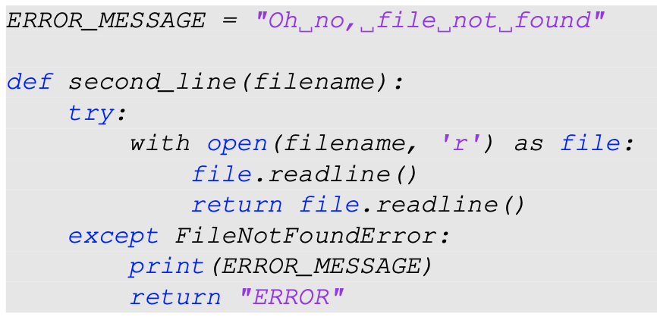
Write a function second_line(filename) that asks the user for the name of a file and then return the second line of the file. Use a try-except block to catch the file not found error and print the error message "Oh no, file not found". If exception is raised, return "ERROR" after printing the error message.

Slide 17
What is an iterator? What are some helpful methods from the itertools library?

Slide 18
What is an iterator? What are some helpful methods from the itertools library?
An iterator keeps track of the traversal of a container

Slide 19
What is an iterator? What are some helpful methods from the itertools library?
An iterator keeps track of the traversal of a container
e.g. loops use iterators to keep track of iteration through a list

Slide 20
What is an iterator? What are some helpful methods from the itertools library?
An iterator keeps track of the traversal of a container
e.g. loops use iterators to keep track of iteration through a list
next(<iterator>)
Progress to the next item in the iterator
Raises a StopIteration exception if the end is reached

Slide 21
What is an iterator? What are some helpful methods from the itertools library?
An iterator keeps track of the traversal of a container
e.g. loops use iterators to keep track of iteration through a list
next(<iterator>)
Progress to the next item in the iterator
Raises a StopIteration exception if the end is reached
Unlike containers (lists, sets, …), iterators can be infinite in length

Slide 22
The itertools library!

Slide 23
The itertools library!
cycle - iterator to cycle through the items in a container, in a loop
product - combine two containers into one tuple, with each item in one container combined with each item in the other
combinations - a sequence of every possible combination of elements in a container
permutations - like combinations, but including different orderings
groupby - group elements of a container together in particular categories

Slide 24
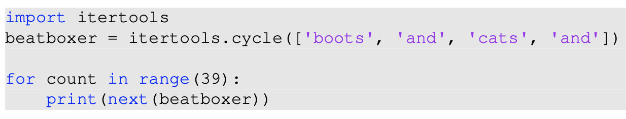
What output does the following code print?

Slide 25
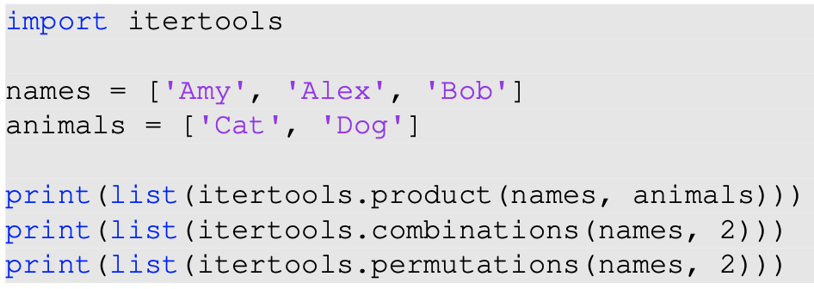
What output does the following code print?

Slide 26
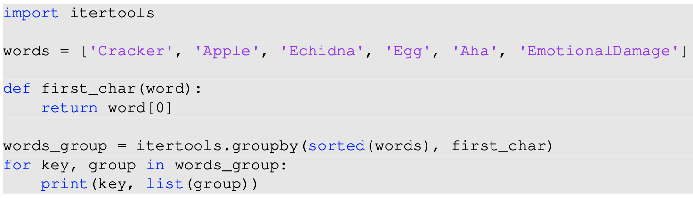
What output does the following code print?

Slide 27
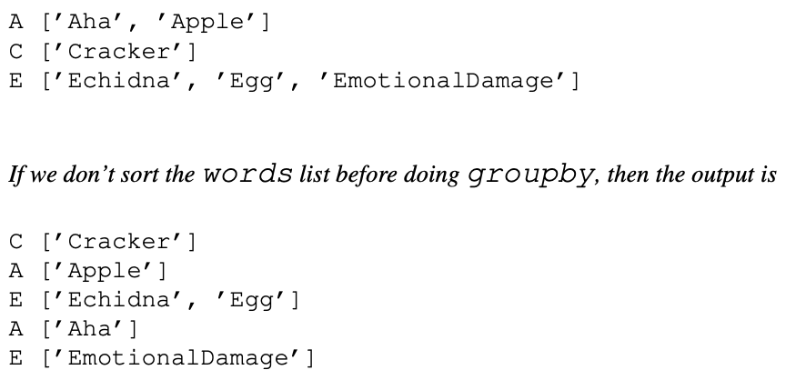
What output does the following code print?

Slide 29
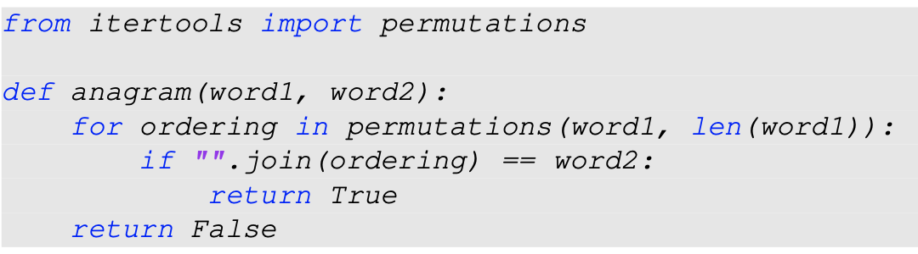

Slide 30
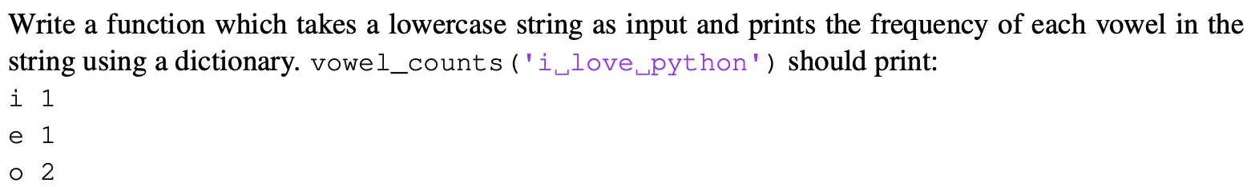
Revision!

Slide 31
Revision!

